Slide 1
Global Intergenerational Week Assembly
Notes:
Global intergenerational week is a campaign to connect all those who are passionate about connecting different generations and reducing ageism. In this assembly we will be reflecting on ageism and thinking about care homes and connecting with older people who live there.

Slide 2
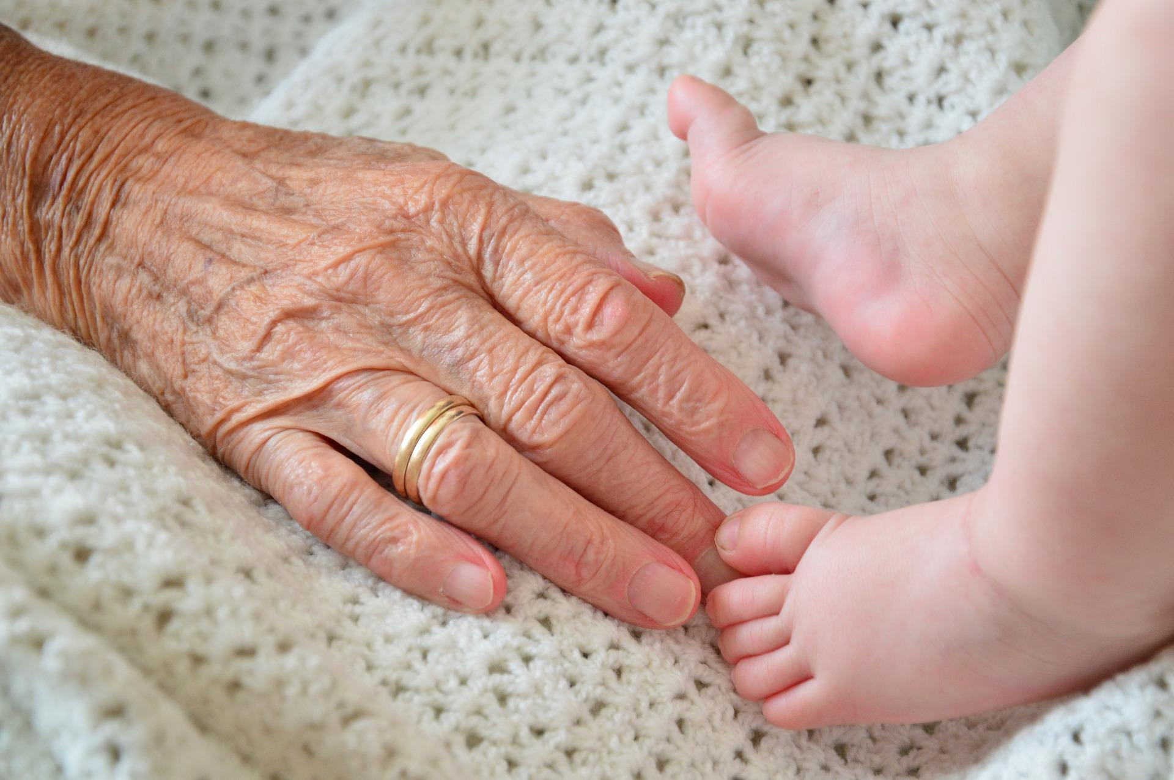
Ageing
What are the best things about being your age?
What are the best things about being older?
What is ageism?
Notes:
Ageism – age discrimination meaning people being treated unfairly due to their age. The Equality Act makes almost all cases of age discrimination against the law.
Image: pixabay

Slide 3
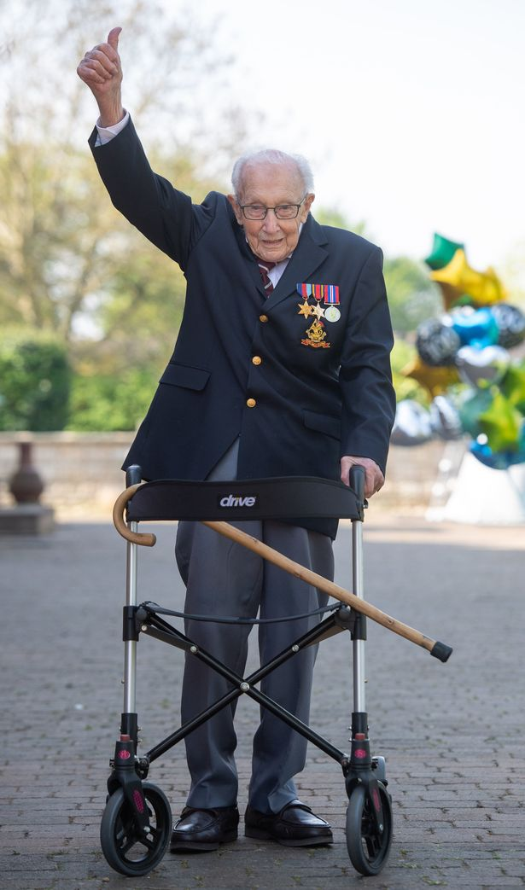
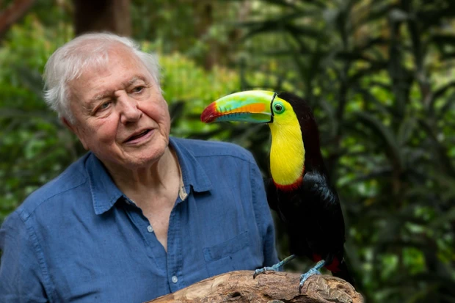
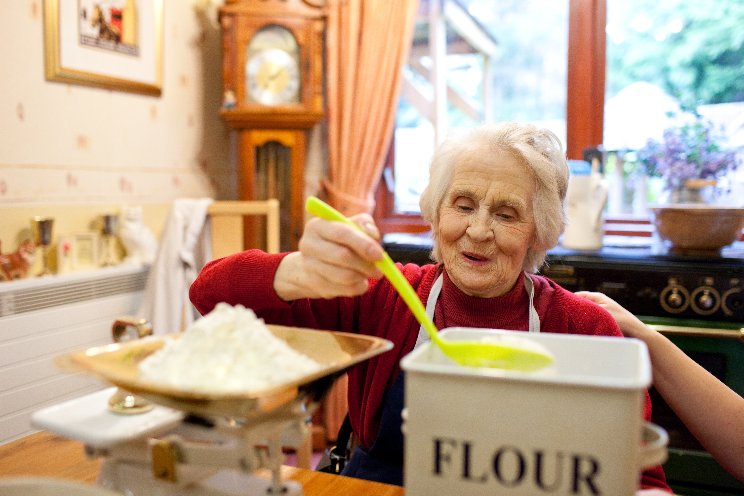
Ageing
Do you know any older people?
What sorts of things do they do with their time?

Slide 4
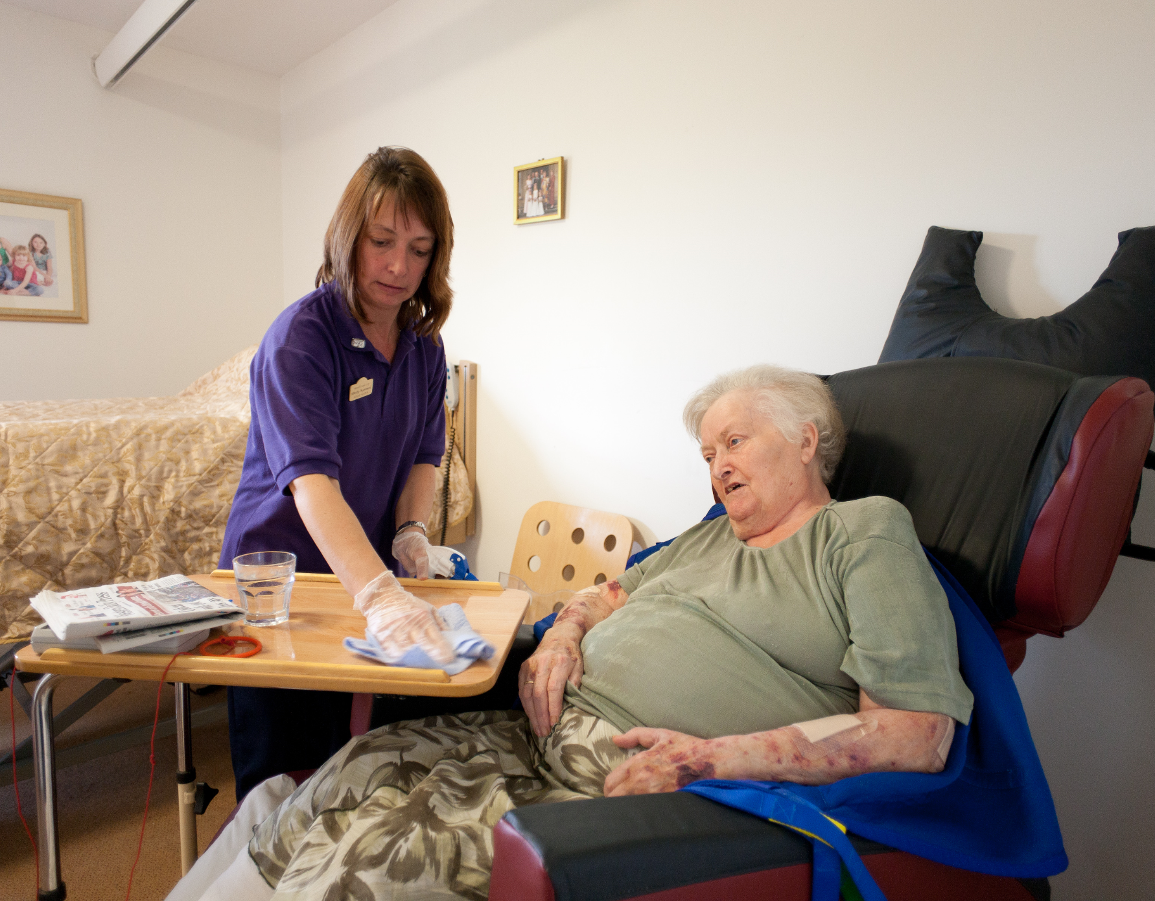
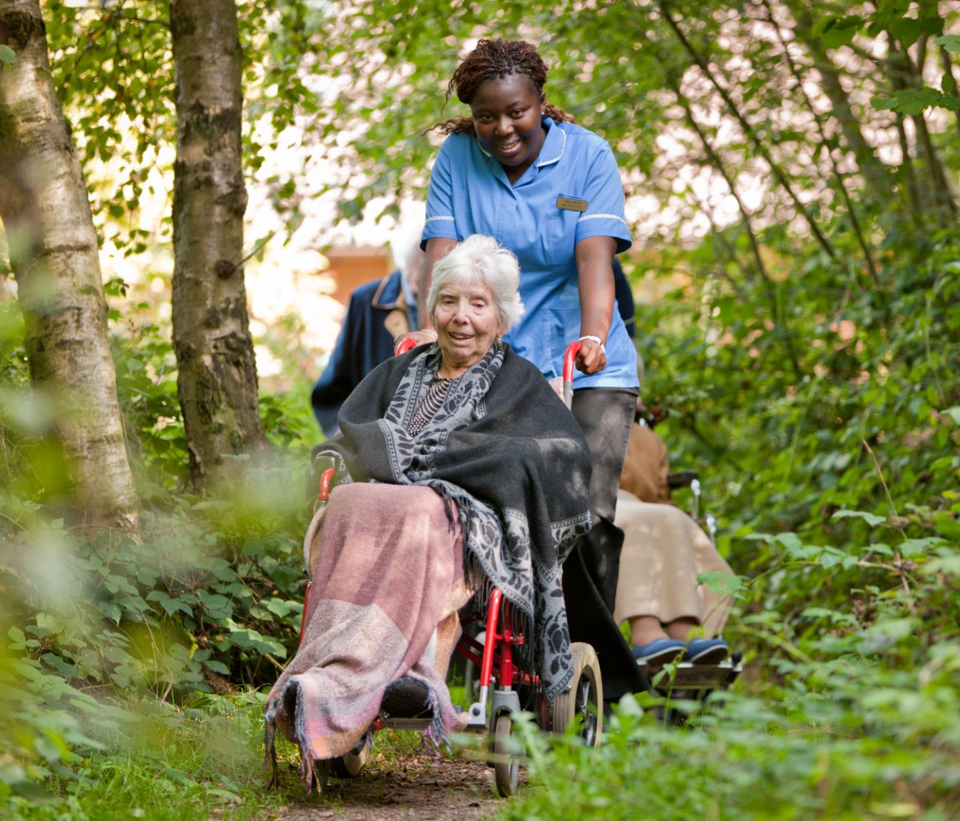
Ageing
Is there anything older people might find harder to do?

Slide 5
Ageing
‘Every time we see an older person we need to imagine them as our future self’
Anne Karpf
Notes:
Draw attention to the fact that we will all most likely be old one day!
Image: https://ageing-better.org.uk/news/range-free-use-age-positive-icons-launched-replace-stereotypical-symbols-ageing

Slide 6
Generations
What does ‘generation’ and ‘intergenerational’ mean’?
Why might it be a good idea to mix with people of different ages?
baby
child
adult
older
person
Notes:
Definitions: generation – all the people born and living at the same time. You might hear people talk about ‘the older or younger generation’.
Intergenerational – different ages and generations mixing together

Slide 7
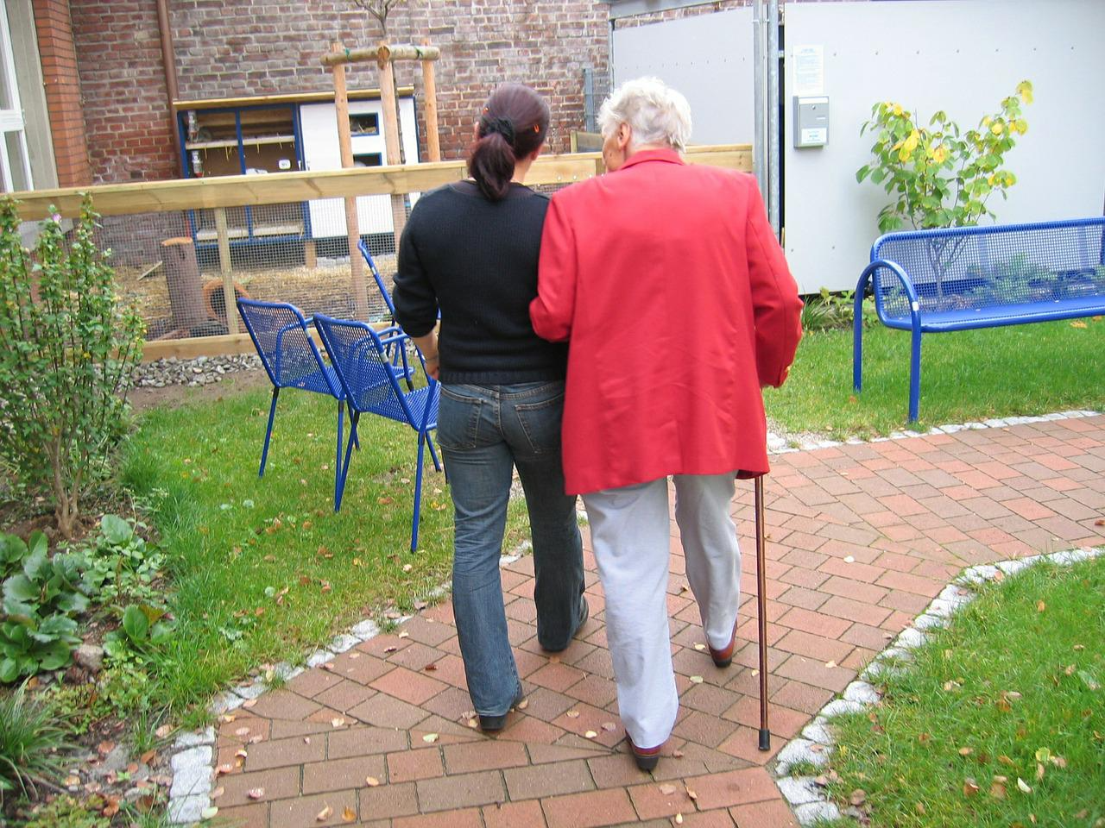
What is a care home?
There are different kinds of care homes. There are care homes for people who have complex medical conditions, who have learning needs and/or are older people.
Some older people may also choose to live in a care home for additional support with day to day living.
Notes:
Image: pixabay

Slide 8
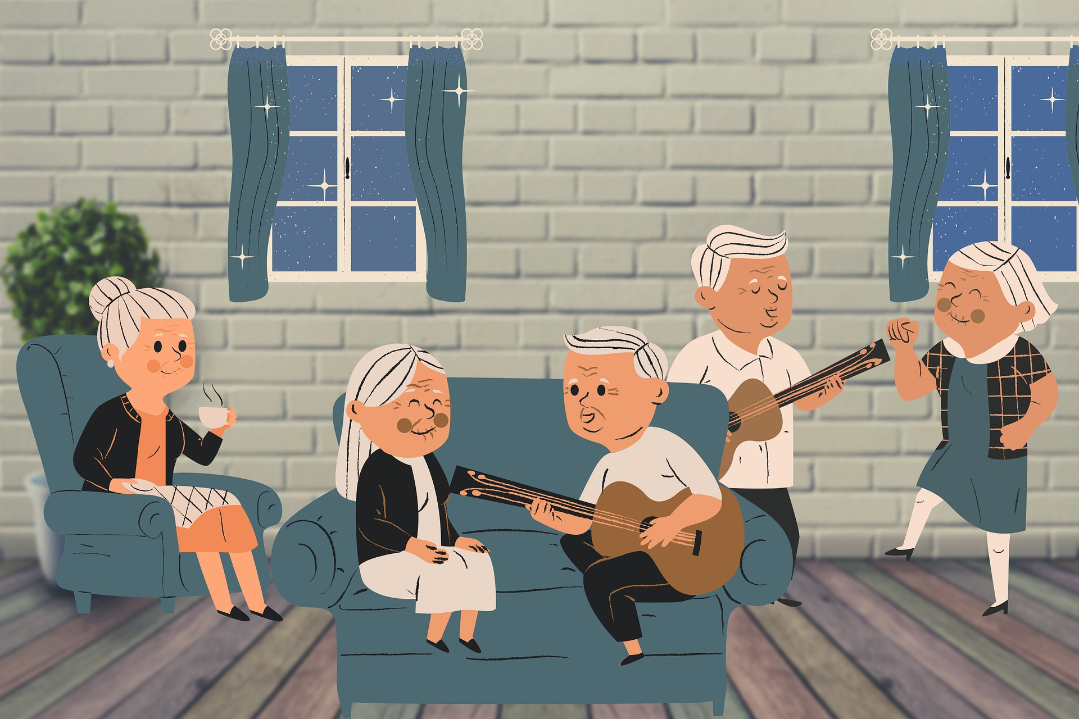
What is a care home?
Care homes for older people usually provide care for those aged 65 and over.
Some provide residential care only, some also provide nursing care and others are specifically designed to support older people living with dementia.
Notes:
Image: pixabay

Slide 9
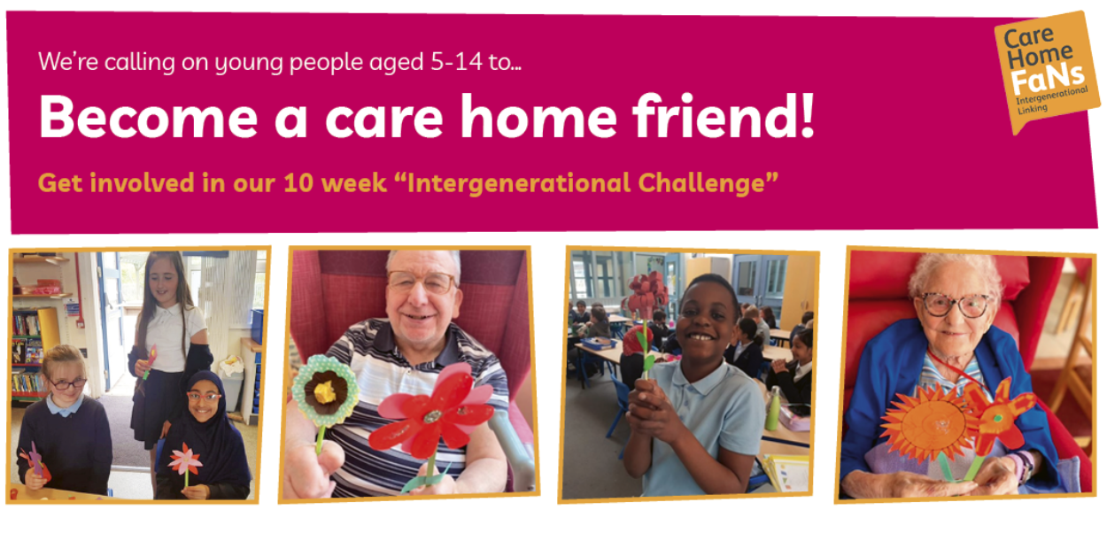
Become a care home friend challenge
Notes:
You may have classes/tutor groups or families taking part in the care home friend challenge: https://myhomelife.org.uk/community-engagement/intergenerational-linking/care-home-friend-challenge/ . You can highlight the challenge ( a weekly activity over 10 weeks learning and making something to send to your local care home) and encourage others to take part at home. Each young person that takes part will receive a certificate.

Slide 10
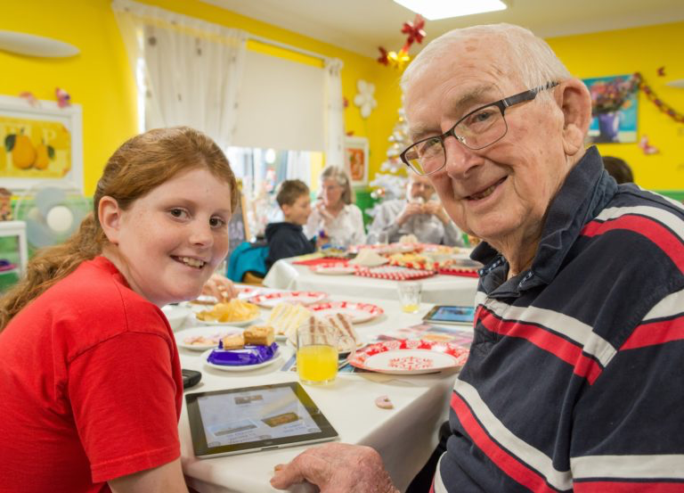
Intergenerational connections
What are the benefits of connecting with older people?
Notes:
Students may recognise that connecting with older people can benefit them in terms of being isolated/ keeping active etc but can they reflect on how they themselves might benefit from getting to know an older person outside of their family? (students might consider wisdom, friendship, new skills, importance of empathy/ compassion and helping others being good for us or even on a practical level that this kind of social action can be useful for future careers)

Slide 11
Time to reflect
What will you remember?
What are you going to do next?
Notes:
Even if students aren’t taking part in the challenge, they may want to think about other actions of kindness and connection they could do for an older person in their family or neighbour.
Faith schools may like to say a prayer as part of their reflection time.
Image: pixabay

